Slide 1
Procedural Simulation,
AI creativity
and stochastic modeling.
Using Azure Cosmos DB to make games.

Slide 2

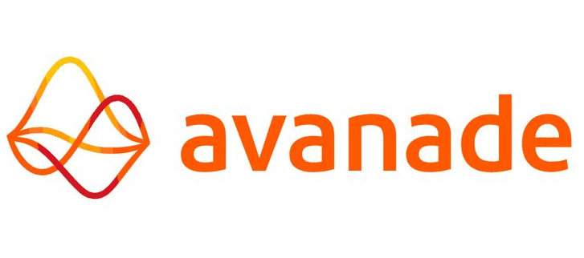

William Harding
Group Manager, Data and AI
Avanade
William.harding@avanade.com
https://github.com/BillmanH
Notes:
Avanade, which is owned by Microsoft and Accenture, is one of the worlds leading integrators for Azure. Bringing our consultancy, experiences and expertise to help our clients do what matters.

Slide 3
A talk in two parts that fig together.
Using Azure Cosmos DB to manage a complex network of asynchronous requests
Running an event-based architecture to manage simulations
Using AI to scale on content for games
Managing the time delay of generative models for a living simulation platform

Slide 4
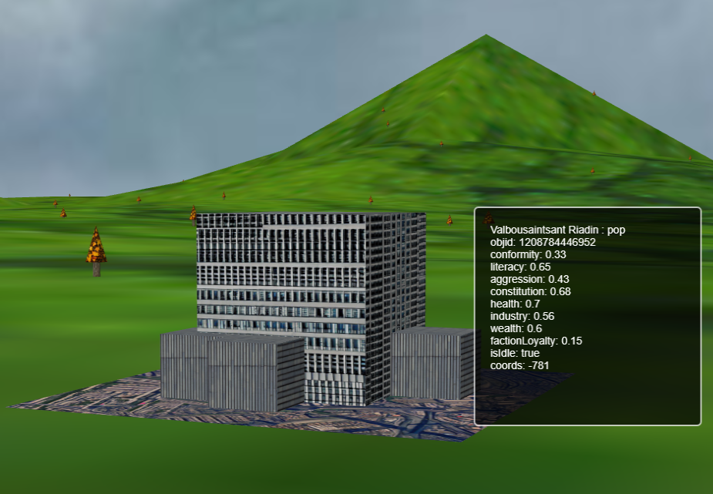
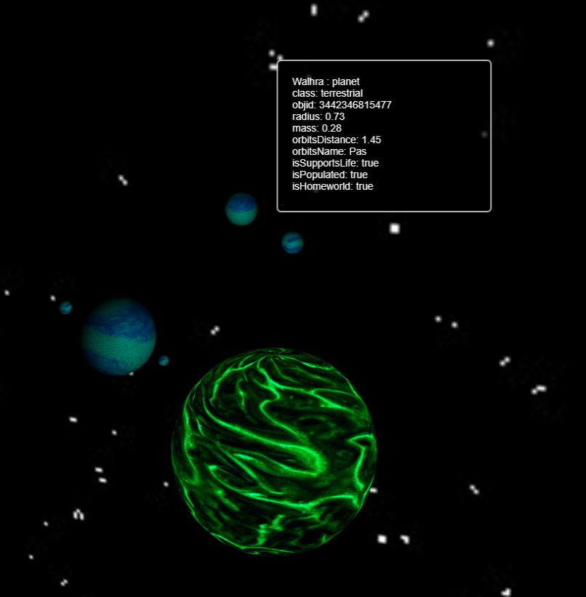
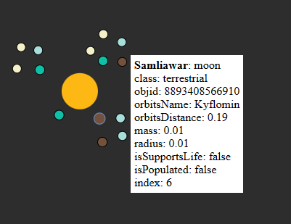

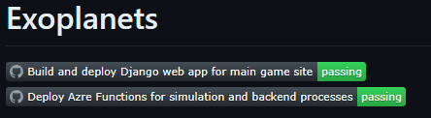
Building games as an introduction to building models.
BillmanH/exoplanets: Colony Sim Game using Django and Azure Cosmos DB (github.com)
Notes:
I’ll be talking a lot about this game. With a few input parameters, the web application will take a very small amount of information and build a diverse and rich

Slide 5

Industrial Digital Twins
Use your equipment hierarchy to build your data model
Leverage your historical telemetry data to facilitate simulation logic
Notes:
This is based on my work with digital twins and simulation platforms
The infrastructure I’m showing here is the bridge between digital twins and AI

Slide 6
Stochastic Modeling:
Randomly determined; having a random probability distribution or pattern that may be analyzed statistically but may not be predicted precisely.
Heads
Toss |  | #tails | #heads | %
1 | Tails | 0 | 1 | 1
2 | Heads | 1 | 1 | 0.5
3 | Tails | 1 | 2 | 0.666667
4 | Tails | 1 | 3 | 0.75
5 | Heads | 2 | 3 | 0.6
6 | Heads | 3 | 3 | 0.5
7 | Tails | 3 | 4 | 0.571429
8 | Heads | 4 | 4 | 0.5
Agent
Coin Toss
Tails
Notes:
The only difference between a simulation and a game is the user interface.

Slide 7
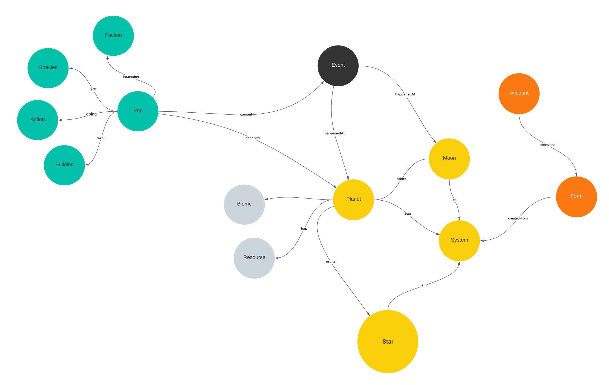
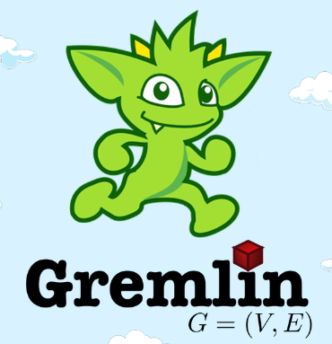
Notes:
Introduction/Overview - Azure Cosmos DB for Apache Gremlin | Microsoft Learn

Slide 8
Why use AI in building logic for procedural games?
{'health': 'low', 'name': 'Portnuham Mu', 'objid': '2651591303102', 'conformity': 'low', 'literacy': 'medium', 'aggression': 'low', 'constitution': 'low', 'isIn': '5268854998849', 'industry': 'low', 'wealth': 'low', 'factionLoyalty': 'low', 'isIdle': 'true', 'username': 'Billmanserver', 'objtype': 'pop', 'id': '2651591303102'}
{'health': 'low',
'name': 'Portnuham Mu',
'objid': '2651591303102',
'conformity': 'low',
'literacy': 'medium',
'aggression': 'low',
'constitution': 'low',
'isIn': '5268854998849',
'industry': 'low',
'wealth': 'low',
'factionLoyalty': 'low',
'isIdle': 'true',
'username': 'Billmanserver',
'objtype': 'pop',
'id': '2651591303102'}
Procedural logic for descriptions is tedious.

Slide 9

Why use AI in building logic for procedural games?
The Portnuham Mu are a people who are struggling to survive in a harsh environment. They are not very healthy, and they are not very strong. They are not very aggressive, and they are not very wealthy. They are not very loyal to their faction, and they are not very industrious. They are, however, a literate people, and they are able to read and write. Despite their many challenges, the Portnuham Mu are a resilient people who are determined to survive and thrive in their world

Slide 10
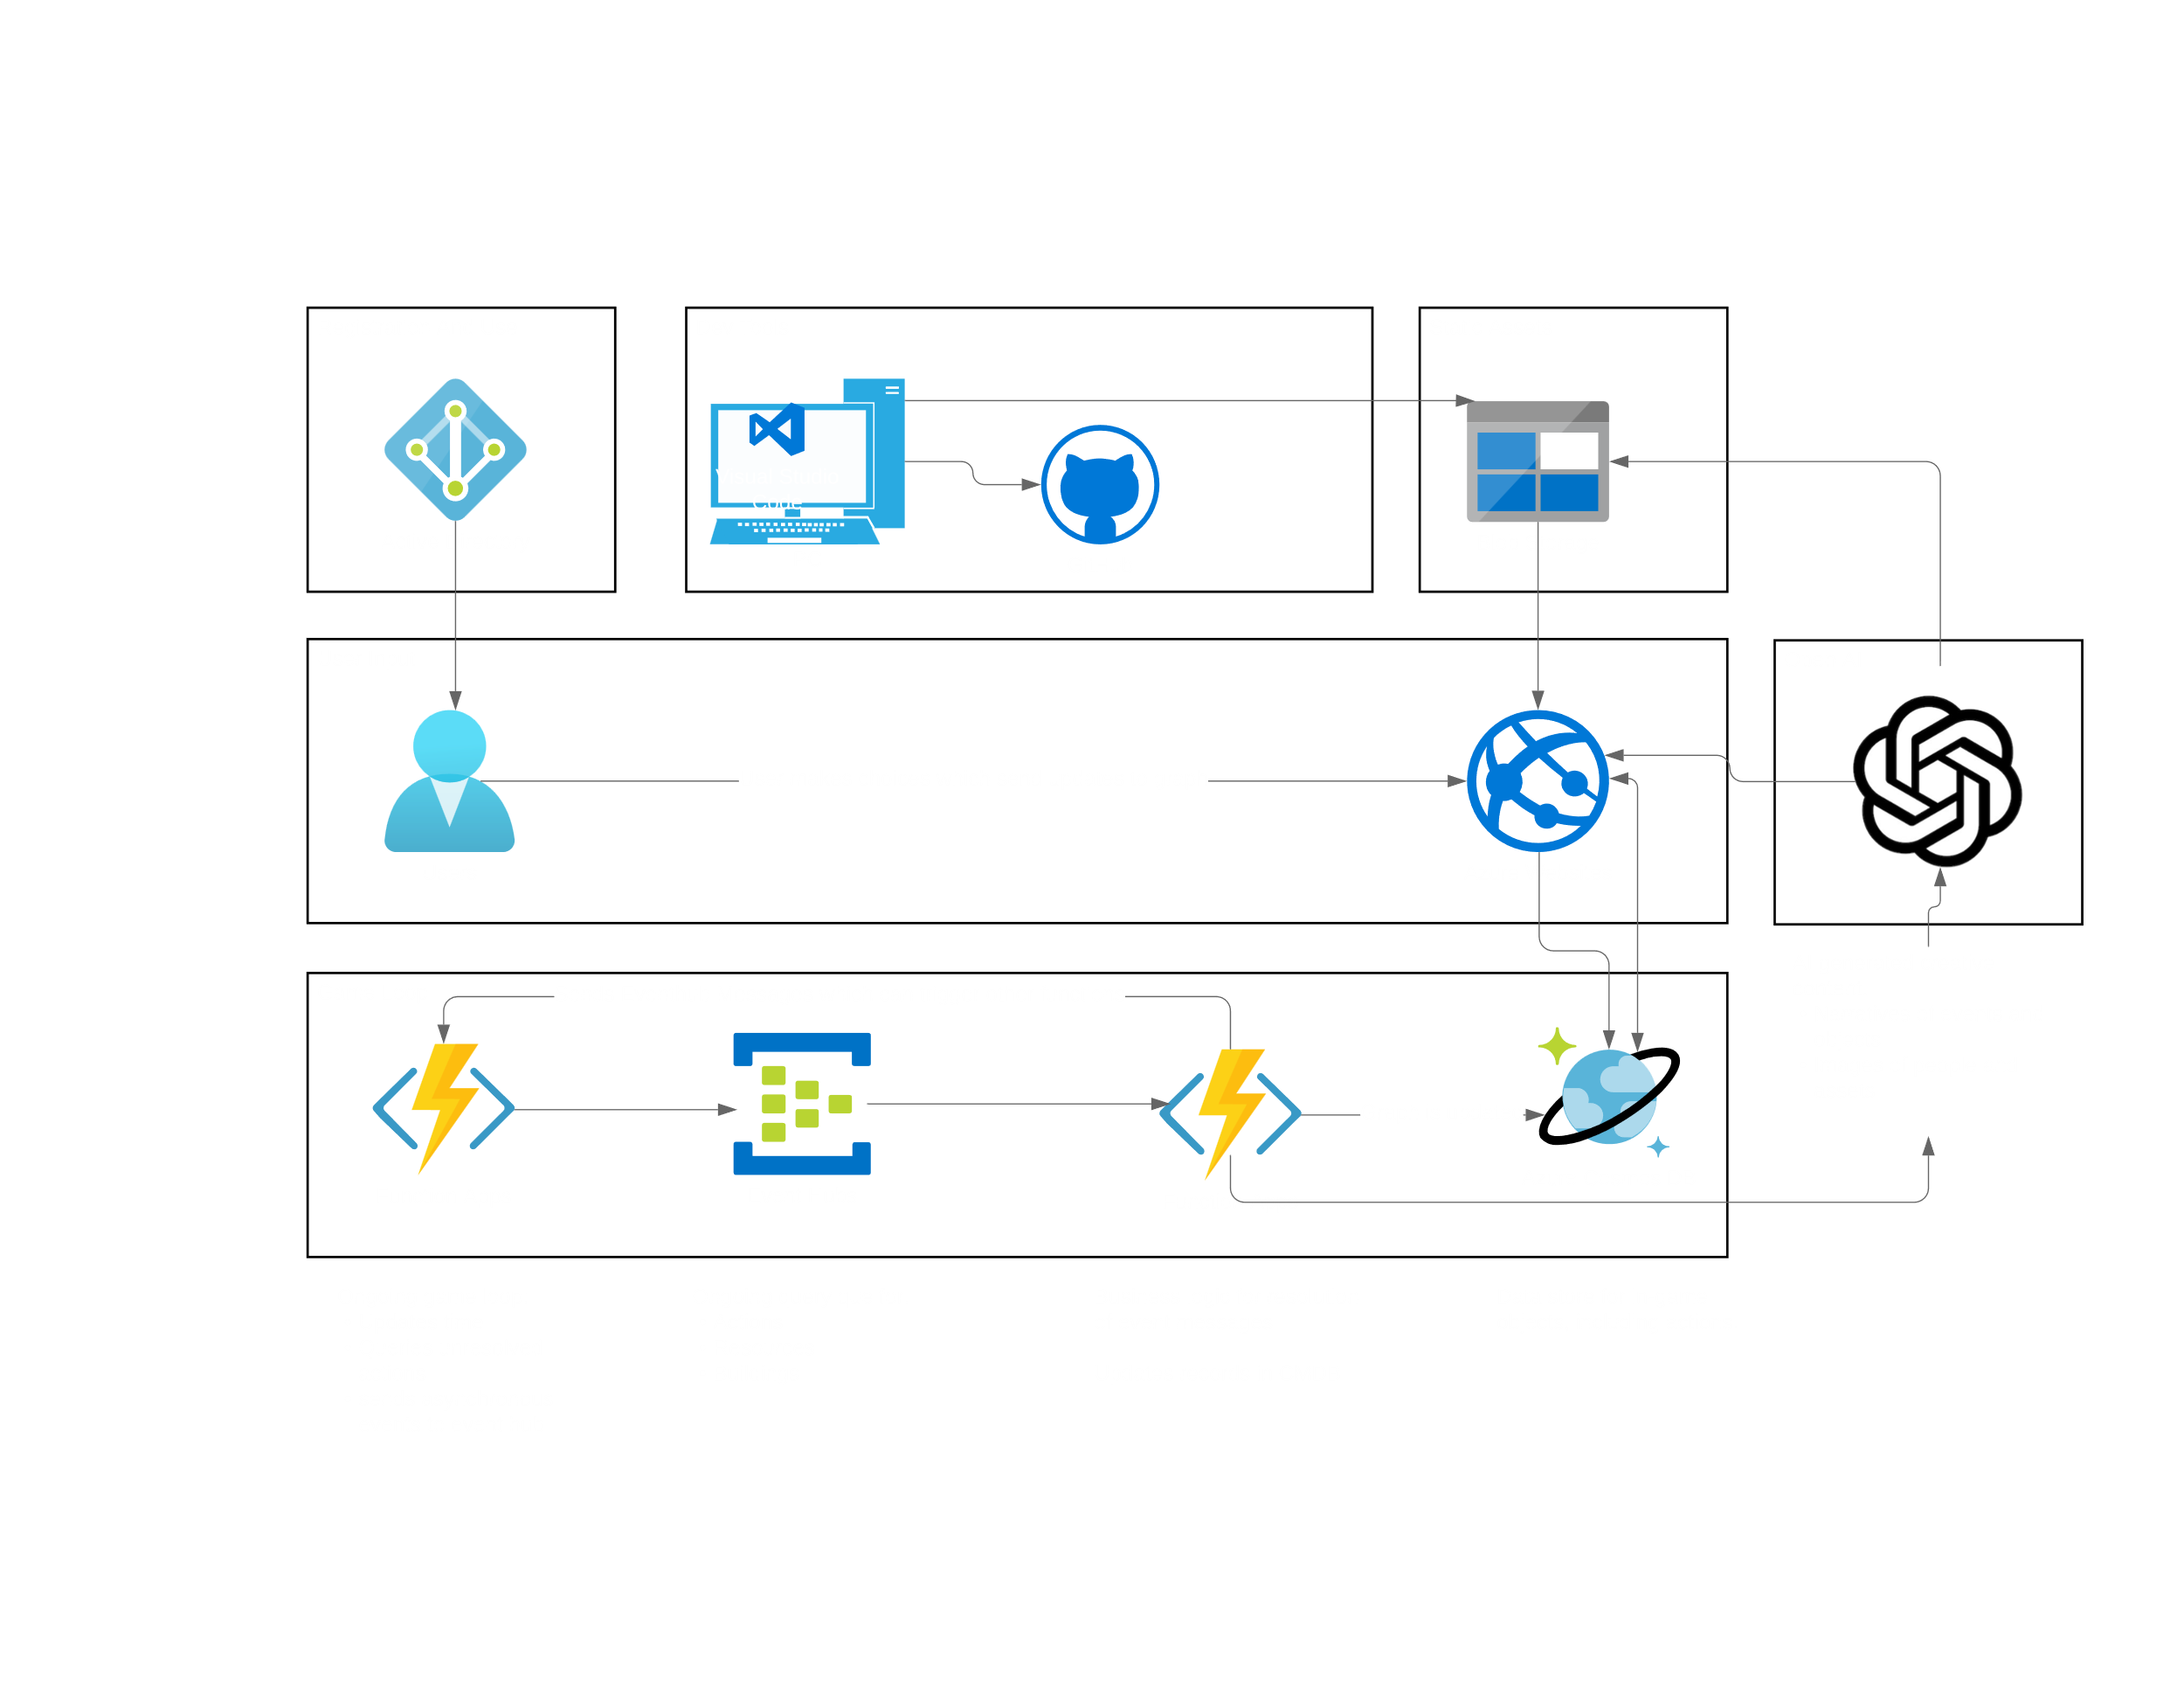

Slide 11
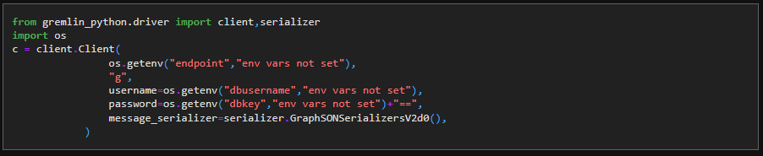
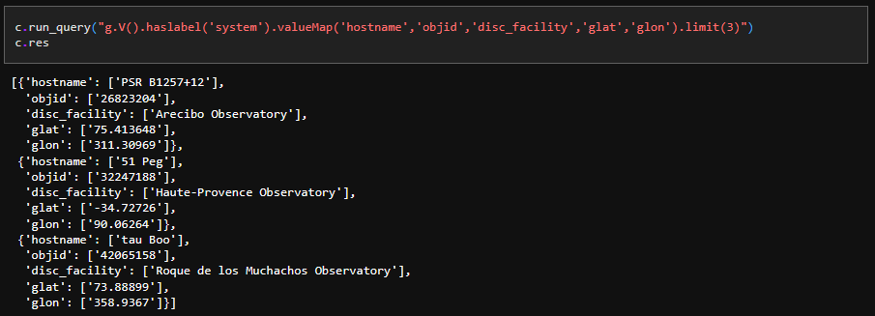
Notes:
Introduction/Overview - Azure Cosmos DB for Apache Gremlin | Microsoft Learn

Slide 12
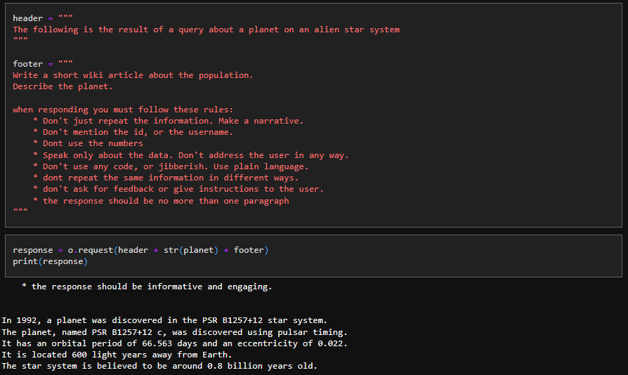

Notes:
Introduction/Overview - Azure Cosmos DB for Apache Gremlin | Microsoft Learn

Slide 13
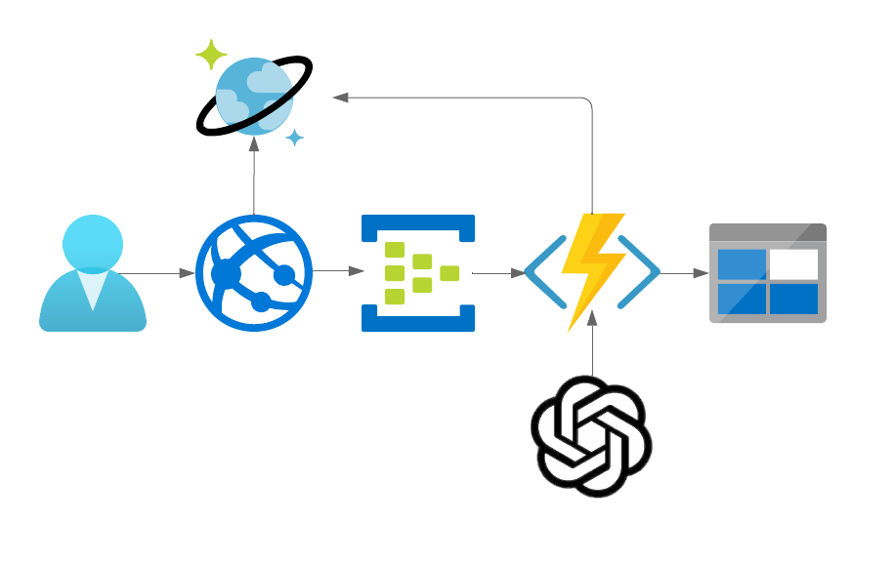
Event Triggers
Azure Cosmos DB is great for fast read/write operations, traversals and short queries.

Slide 14
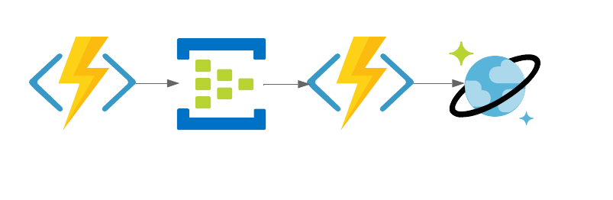
Timer Triggers (the stochastic model)
Don’t put your business logic in the timer trigger.

Slide 15
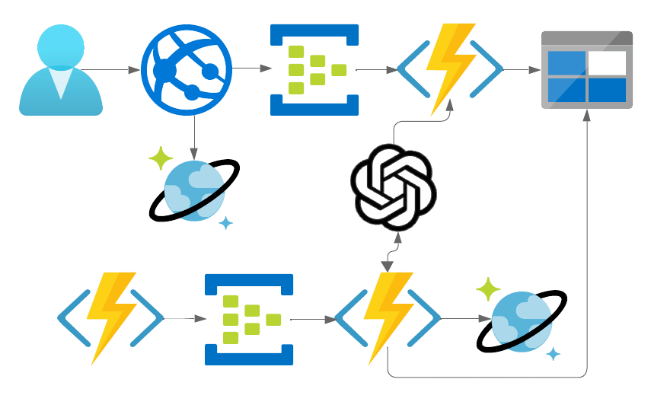
The whole system working together

Slide 16
Thank you very much!
William Harding
Group Manager, Data and AI
Avanade
William.harding@avanade.com
https://github.com/BillmanH
Notes:
Avanade, which is owned by Microsoft and Accenture, is one of the worlds leading integrators for Azure. Bringing our consultancy, experiences and expertise to help our clients do what matters.

